Slide 1
Oracle 12c: SQL
Chapter 4
Constraints
©2016. Cengage Learning. All rights reserved.

Slide 2
Objectives
Explain the purpose of constraints in a table
Distinguish among PRIMARY KEY, FOREIGN KEY, UNIQUE, CHECK, and NOT NULL constraints and the appropriate use for each constraint
Understand how constraints can be created when creating a table or modifying an existing table
Distinguish between creating constraints at the column level and table level
©2016. Cengage Learning. All rights reserved.

Slide 3
Objectives (continued)
Create PRIMARY KEY constraints for a single column and a composite primary key
Create a FOREIGN KEY constraint
Create a UNIQUE constraint
Create a CHECK constraint
©2016. Cengage Learning. All rights reserved.

Slide 4
Objectives (continued)
Create a NOT NULL constraint using the ALTER TABLE…MODIFY command
Include constraints during table creation
Use DISABLE and ENABLE commands
Use the DROP command
©2016. Cengage Learning. All rights reserved.

Slide 5
Constraints
Rules used to enforce business rules, practices, and policies
Rules used to ensure accuracy and integrity of data
IF . . .
Order placed Feb 2, 2019
Order shipped Jan 28, 2019
PROBLEM!
©2016. Cengage Learning. All rights reserved.

Slide 6
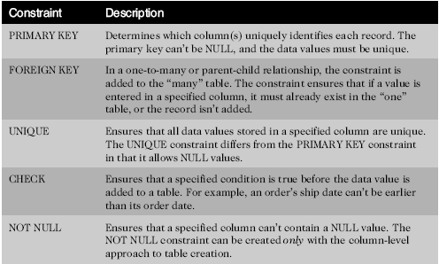
Constraint Types
_pk
_fk
_uk
_ck
_nn
©2016. Cengage Learning. All rights reserved.

Slide 7
Creating Constraints
Use the optional CONSTRAINT keyword during creation to assign a name
The server will name the constraint using the default format SYS_Cn
        n = an assigned numeric value to make it unique
Informative names can assist in debugging, so assigning your own name is useful
©2016. Cengage Learning. All rights reserved.

Slide 8
Creating Constraints (continued)
When
  During table creation
  After table creation, by modifying the existing table
How
  Column level approach
  Table level approach
©2016. Cengage Learning. All rights reserved.

Slide 9
Creating Constraints at the Column Level
If a constraint is being created at the column level, the constraint applies to the column specified
©2016. Cengage Learning. All rights reserved.

Slide 10
Constraint type Keywords
Any type of constraint can be applied at the column level . . . .
. . . .unless the constraint is being used to define more then one row (ie. Composite primary keys). The constraint must then be done at the TABLE level.
©2016. Cengage Learning. All rights reserved.

Slide 11
Creating Constraints at the Table Level
Constraints are different then column definition
Approach can be used to create any constraint type except NOT NULL
Required if constraint is based on multiple columns
©2016. Cengage Learning. All rights reserved.

Slide 12
Enforcement of Constraints
All constraints are enforced at the row level
If a data value violates a constraint, the entire row is rejected
©2016. Cengage Learning. All rights reserved.

Slide 13
Adding Constraints to Existing Tables
Constraints are added to an existing table with the ALTER TABLE command
Add a NOT NULL constraint using MODIFY clause
All other constraints are added using ADD clause
©2016. Cengage Learning. All rights reserved.

Slide 14
Using the PRIMARY KEY Constraint
Ensures that columns do not contain duplicate or NULL values
Only one per table is allowed
©2016. Cengage Learning. All rights reserved.

Slide 15
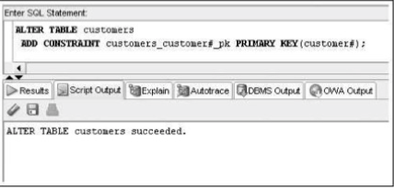
How do you test your constraints?
Keep in mind that the purpose of a constraint is to check whether data values being entered are valued. So try entering some data. . .

Slide 16
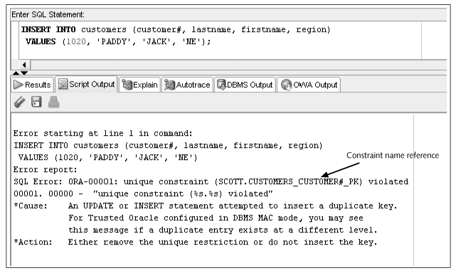
Constraint Checked with Data Input
©2016. Cengage Learning. All rights reserved.

Slide 17
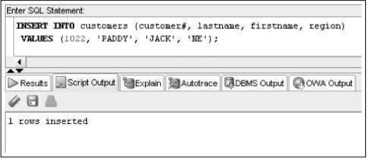
Oracle 11g: SQL

Slide 18
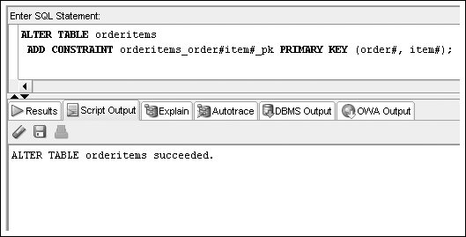
PRIMARY KEY Constraint for Composite Key
List column names within parentheses separated by commas

Slide 19
Using the FOREIGN KEY Constraint
Requires a value to exist in the referenced column of another table
NULL values are allowed
Enforces referential integrity
Maps to the PRIMARY KEY in parent table
©2016. Cengage Learning. All rights reserved.

Slide 20
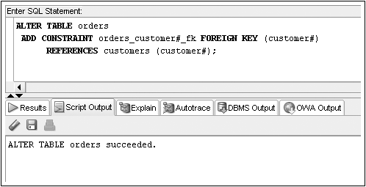
FOREIGN KEY Constraint Example
©2016. Cengage Learning. All rights reserved.

Slide 21
Deletion of Foreign Key Values
You cannot delete a value in a parent table referenced by a row in a child table
Use ON DELETE CASCADE keywords when creating FOREIGN KEY constraint – it automatically deletes a parent row when the row in a child table is deleted
©2016. Cengage Learning. All rights reserved.

Slide 22
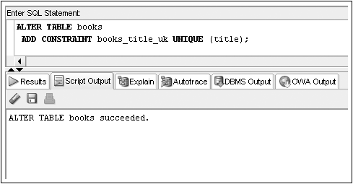
Using the UNIQUE Constraint
No duplicates are allowed in the referenced column
NULL values are permitted
©2016. Cengage Learning. All rights reserved.

Slide 23
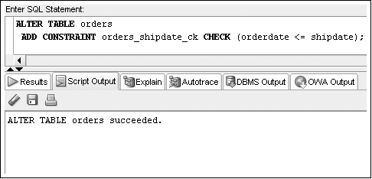
Using the CHECK Constraint
Updates and additions must meet specified condition
©2016. Cengage Learning. All rights reserved.

Slide 24
Using the NOT NULL Constraint
The NOT NULL constraint is a special CHECK constraint with IS NOT NULL condition
Can only be created at column level
Included in output of DESCRIBE command
Can only be added to an existing table using ALTER TABLE…MODIFY command
©2016. Cengage Learning. All rights reserved.

Slide 25
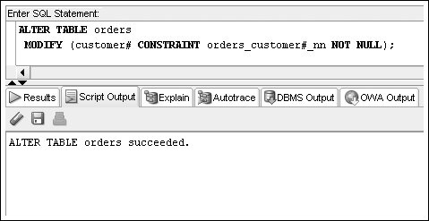
NOT NULL Constraint Example
©2016. Cengage Learning. All rights reserved.

Slide 26

Including Constraints during Table Creation – Column Level
Include in column definition
©2016. Cengage Learning. All rights reserved.

Slide 27
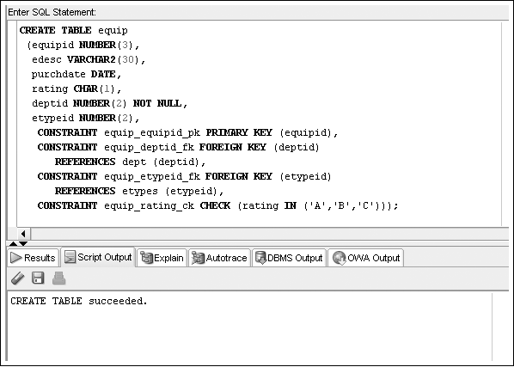
Including Constraints during Table Creation – Table Level
Include at end of column list
©2016. Cengage Learning. All rights reserved.

Slide 28
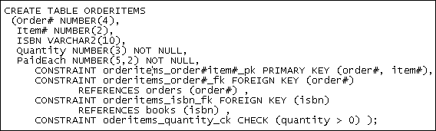
Multiple Constraints on a Single Column
A column may be included in multiple constraints
The order# column is included in a primary key and a foreign key constraint
©2016. Cengage Learning. All rights reserved.

Slide 29
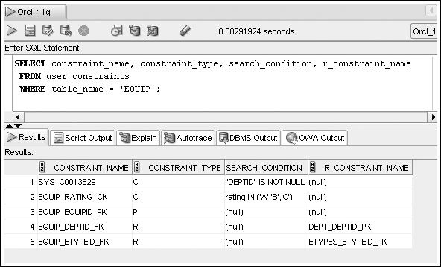
Viewing Constraints – USER_CONSTRAINTS
Display constraint listing for a specific table
©2016. Cengage Learning. All rights reserved.

Slide 30
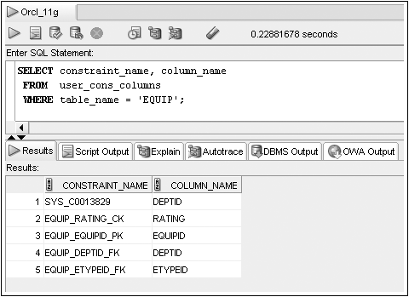
Viewing Constraints – USER_CONS_COLUMNS
Display constraint listing by column
©2016. Cengage Learning. All rights reserved.

Slide 31
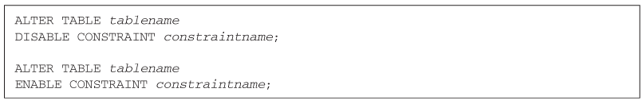
Using DISABLE/ENABLE
Use DISABLE or ENABLE clause of ALTER TABLE command
©2016. Cengage Learning. All rights reserved.

Slide 32
Dropping Constraints
Constraints cannot be modified; they must be dropped and recreated
Actual syntax depends on type of constraint
  PRIMARY KEY – just list type of constraint
  UNIQUE – include column name
  All others – reference constraint name
©2016. Cengage Learning. All rights reserved.

Slide 33

ALTER TABLE…DROP Syntax
©2016. Cengage Learning. All rights reserved.

Slide 34
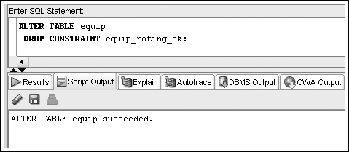
Drop Constraint Example
©2016. Cengage Learning. All rights reserved.

Slide 35
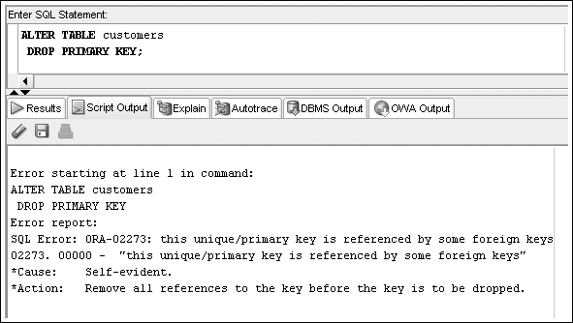
Drop Constraint Example – Error
©2016. Cengage Learning. All rights reserved.

Slide 36
Summary
A constraint is a rule that is applied to data being added to a table
  The constraint represents business rules, policies, and/or procedures
  Data violating the constraint is not added to the table
A constraint can be included during table creation as part of the CREATE TABLE command or added to an existing table using the ALTER TABLE command
©2016. Cengage Learning. All rights reserved.

Slide 37
Summary (continued)
A PRIMARY KEY constraint does not allow duplicate or NULL values in the designated column
Only one PRIMARY KEY constraint is allowed in a table
A FOREIGN KEY constraint requires that the column entry match a referenced column entry in the referenced table or be NULL
A UNIQUE constraint is similar to a PRIMARY KEY constraint except it allows NULL values to be stored in the specified column
A CHECK constraint ensures a value meets a specified condition
©2016. Cengage Learning. All rights reserved.

Slide 38
Summary (continued)
A NOT NULL constraint ensures a value is provided for a column
A constraint can be disabled or enabled using the ALTER TABLE command and the DISABLE and ENABLE keywords
A constraint cannot be modified
  To change a constraint, the constraint must first be dropped with the DROP command and then re-created
USER_CONSTRAINTS and USER_CONS_COLUMNS data dictionary views provide information regarding constraints
©2016. Cengage Learning. All rights reserved.

Slide 39
Try it out . . . .
Modify the following SQL command so that the Rep_ID column is the PRIMARY KEY for the table and the default value of Y is assigned to the Comm column. (The Comm column indicates whether the sales representative earns commission.)
      CREATE TABLE store_reps
      (rep_ID NUMBER(5),
      last VARCHAR2(15),
      first VARCHAR2(10),
      comm CHAR(1));
Oracle 11g: SQL

Slide 40
Try it out . . . .
Modify the following SQL command so that the Rep_ID column is the PRIMARY KEY for the table and the default value of Y is assigned to the Comm column. (The Comm column indicates whether the sales representative earns commission.)
CREATE TABLE store_reps
(rep_ID NUMBER(5),
last VARCHAR2(15),
first VARCHAR2(10),
comm CHAR(1));
CREATE TABLE store_reps
(rep_id NUMBER(5),
last VARCHAR2(15),
first VARCHAR2(10),
comm CHAR(1) DEFAULT 'Y',
CONSTRAINT storereps_id_pk PRIMARY KEY (rep_id) );
Oracle 11g: SQL

Slide 41
Try it out. . .
Change the STORE_REPS table so that NULL values can’t be entered in the name columns (First and Last).
ALTER TABLE store_reps
MODIFY (last NOT NULL,
first NOT NULL);
Oracle 11g: SQL

Slide 42
Try it out . . .
Change the STORE_REPS table so that only a Y or N can be entered in the Comm column.
ALTER TABLE store_reps
ADD CONSTRAINT storereps_comm_ck CHECK (comm IN('Y','N'));
Oracle 11g: SQL

